Slide 1
TOAH.
Portal to re-define solution to bringing people connected to the services

Slide 2
Scenario
* In 2016, more than 16,000 unique individuals used the City-administered emergency shelter system.
* 3,583 people likely have more complex challenges and need supportive housing in a year.
5,092 people were using the City’s emergency shelter system

Slide 3
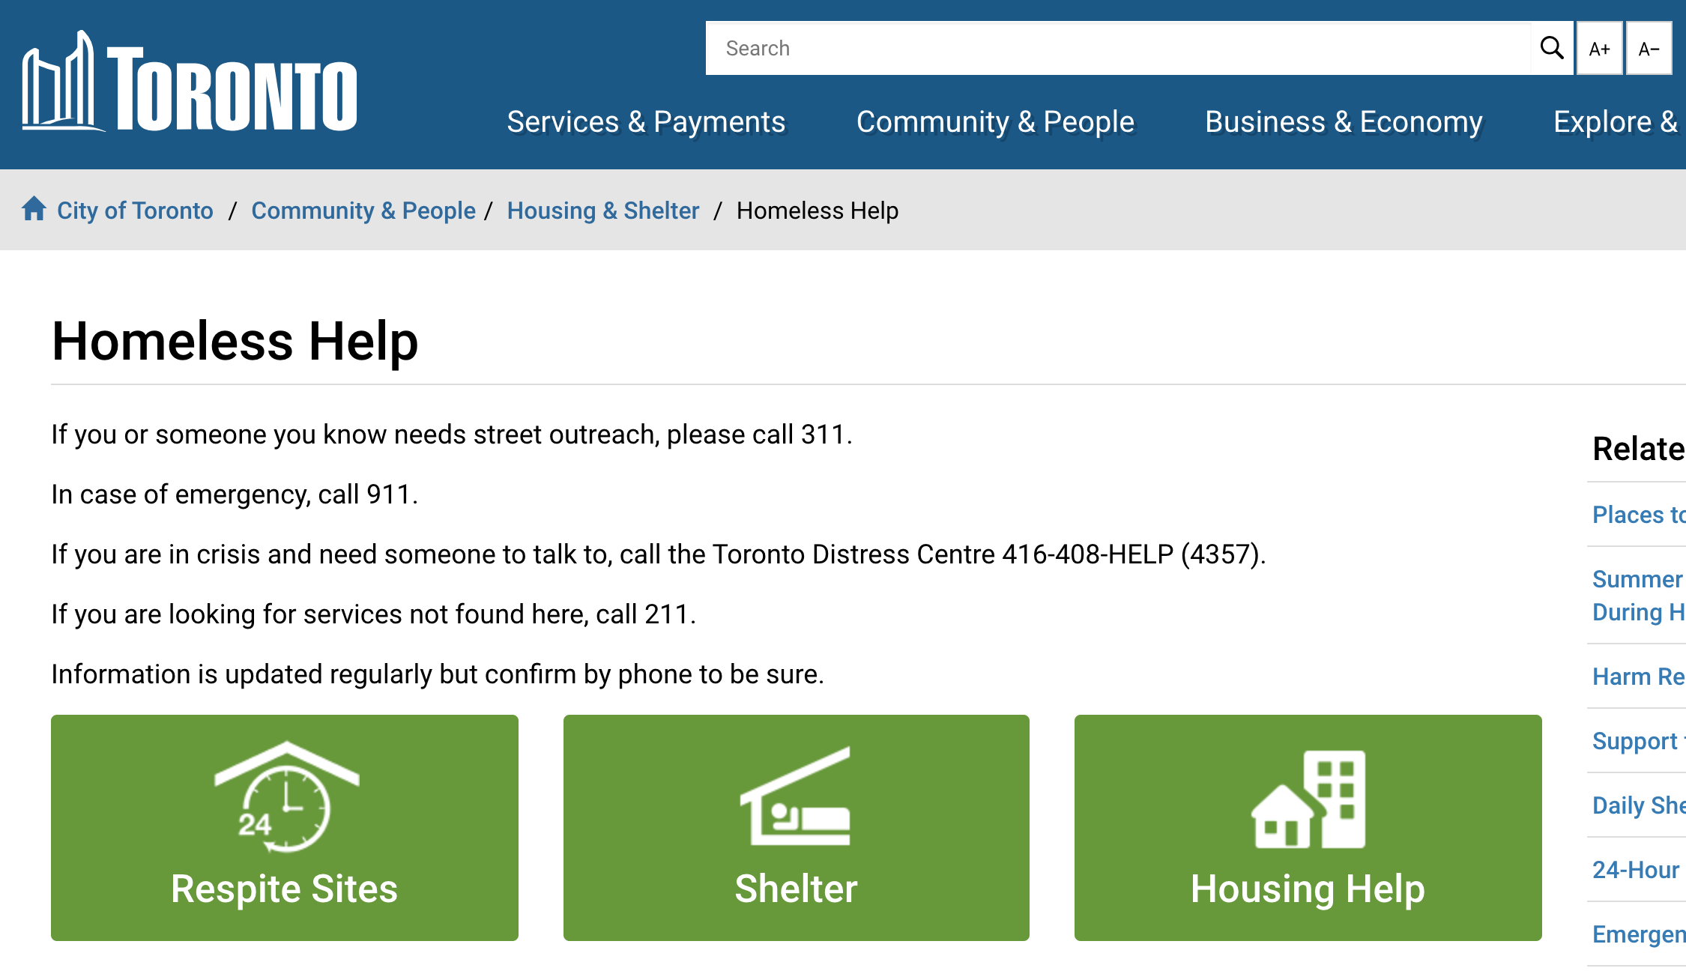
Solution?
User are required to visit the Toronto website and locate the directory for the listing
User needs to be in a 5-level sub-directory just to find the service listing.
The Toronto website is heavily crowded with many contents.
No structure for listing all services offered in the city.
These services also require separate separate application which is needed to be filled by the user

Slide 4
TOAH.
TORONTO ACTIVE HUB

Slide 5
Solution!
01
03
A portal page to bring all services offered from City council website to one united application. Users will use the application to make use of the services via one application.
02
One-Step Registration
Chatbot + agent integeration
Users will need to register once to the application, using the same process the Canadian government website uses.
User require help? Automation to the rescue. Chatbot solution to provide end-users with ability to interact for finding details or services. Users are also able to connect to live agent, if available.
Dynamic Map Listing
Google Map listing and search functionality of all services offered from City council website. These references will link to further details for each organization

Slide 6
Portal
01
A peep at some distant orb has power to raise and purify our thoughts like a strain of sacred music, or a noble picture.

Slide 7
Registration
01
A peep at some distant orb has power to raise and purify our thoughts like a strain of sacred music, or a noble picture.

Slide 8
Chatbot
01
A peep at some distant orb has power to raise and purify our thoughts like a strain of sacred music, or a noble picture.

Slide 9
Map Listing
01
A peep at some distant orb has power to raise and purify our thoughts like a strain of sacred music, or a noble picture.

Slide 10
Benefit of TOAH.
SECTION 1
SECTION 2
SECTION 3
YOUR TITLE HERE
A peep at some distant orb has power to raise and purify our thoughts like a strain of sacred music, or a noble picture, or a passage from the grander poets. It always does one good.
400K
WRITE TITLE HERE
2.572M
WRITE TITLE HERE

Slide 11
Usability of TOAH.
SERVICE #1
A peep at some distant orb has power to raise and purify our thoughts like a strain of sacred music.
SERVICE #2
A peep at some distant orb has power to raise and purify our thoughts like a strain of sacred music.

Slide 12
Technicality of TOAH.
01
02
03
Front-End Code
Back-End Code
Server
A peep at some distant orb has power to raise and purify our thoughts like a strain of sacred music, or a noble picture, or a passage from. A peep at some distant orb has power to raise. A peep at some distant orb has power to raise and purify our thoughts like a strain of sacred music, or a noble picture, or a passage from the grander poets.
A peep at some distant orb has power to raise and purify our thoughts like a strain of sacred music, or a noble picture, or a passage from. A peep at some distant orb has power to raise. A peep at some distant orb has power to raise and purify our thoughts like a strain of sacred music, or a noble picture, or a passage from the grander poets.
A peep at some distant orb has power to raise and purify our thoughts like a strain of sacred music, or a noble picture, or a passage from. A peep at some distant orb has power to raise. A peep at some distant orb has power to raise and purify our thoughts like a strain of sacred music, or a noble picture, or a passage from the grander poets.

Slide 13
Good Bye!

